Slide 1
CS 61C: Great Ideas in Computer Architecture More RISC-V Instructions and How to Implement Functions
Instructors:
Krste Asanović and Randy H. Katz
http://inst.eecs.Berkeley.edu/~cs61c/fa17
9/14/17
Fall 2017 - Lecture #6

Slide 2
Outline
RISC-V ISA and C-to-RISC-V Review
Program Execution Overview
Function Call
Function Call Example
And in Conclusion …
9/14/17

Slide 3
Outline
RISC-V ISA and C-to-RISC-V Review
Program Execution Overview
Function Call
Function Call Example
And in Conclusion …
9/14/17

Slide 4
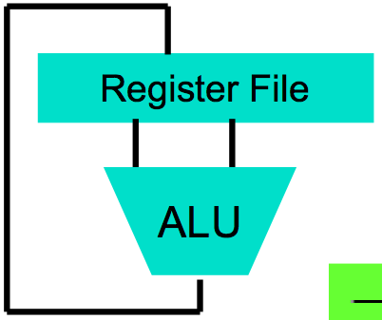
Levels of Representation/Interpretation
High-Level Language Program (e.g., C)
temp = v[k];
v[k] = v[k+1];
v[k+1] = temp;
Compiler
Anything can be represented as a number, i.e., data or instructions
lw x10, 0(x12)
lw x11, 4(x12)
sw x11, 0(x12)
sw x10, 4(x12)
Assembly Language Program (e.g., RISC-V)
Assembler
0000 1001 1100 0110 1010 1111 0101 1000
1010 1111 0101 1000 0000 1001 1100 0110
1100 0110 1010 1111 0101 1000 0000 1001
0101 1000 0000 1001 1100 0110 1010 1111
Machine Language Program (RISC-V)
Machine Interpretation
Hardware Architecture Description (e.g., block diagrams)
Architecture Implementation
Logic Circuit Description (Circuit Schematic Diagrams)
9/14/17

Slide 5
Review From Last Lecture …
Computer “words” and “vocabulary” are called instructions and instruction set respectively
RISC-V is example RISC instruction set used in CS61C
Lecture/problems use 32-bit RV32 ISA, book uses 64-bit RV64 ISA
Rigid format: one operation, two source operands, one destination
add,sub,mul,div,and,or,sll,srl,sra
lw,sw,lb,sb to move data to/from registers from/to memory
beq, bne, j for decision/flow control
Simple mappings from arithmetic expressions, array access, in C to RISC-V instructions
9/14/17

Slide 6
Recap: Registers live inside the Processor
Processor
Memory
Enable?
Read/Write
Input
Control
Program
Datapath
Address
PC
Bytes
Registers
Write Data
Arithmetic & Logic Unit
(ALU)
Data
ReadData
Output
Processor-Memory Interface
I/O-Memory Interfaces
Notes:
focus memory

Slide 7
Example if-else Statement
Assuming translations below, compile
f → x10 g → x11 h → x12
i → x13 j → x14
if (i == j) bne x13,x14,Else
f = g + h; add x10,x11,x12
else j Exit
f = g – h; Else: sub x10,x11,x12
Exit:
9/14/17

Slide 8
Magnitude Compares in RISC-V
Until now, we’ve only tested equalities (== and != in C); General programs need to test < and > as well.
RISC-V magnitude-compare branches:
“Branch on Less Than”
Syntax: blt reg1,reg2, label
Meaning: if (reg1 < reg2) // treat registers as signed integers goto label;
“Branch on Less Than Unsigned”
Syntax: bltu reg1,reg2, label
Meaning: if (reg1 < reg2) // treat registers as unsigned integers goto label;
9/14/17

Slide 9
C Loop Mapped to RISC-V Assembly
int A[20];
int sum = 0;
for (int i=0; i<20; i++)
sum += A[i];
addi x9, x8, 0 # x9=&A[0]
addi x10, x0, 0 # sum=0
addi x11, x0, 0 # i=0
Loop:
lw x12, 0(x9) # x12=A[i]
add x10,x10,x12 # sum+=
addi x9,x9,4 # &A[i++]
addi x11,x11,1 # i++
addi x13,x0,20 # x13=20
blt x11,x13,Loop

Slide 10
Peer Instruction
Which of the following is TRUE?
RED: add x10,x11,4(x12)is valid in RV32
GREEN: can byte address 8GB of memory with an RV32 word
ORANGE: imm must be multiple of 4 for lw x10,imm(x10) to be valid
YELLOW: None of the above
9/14/17

Slide 11
Peer Instruction
Which of the following is TRUE?
RED: add x10,x11,4(x12)is valid in RV32
GREEN: can byte address 8GB of memory with an RV32 word
ORANGE: imm must be multiple of 4 for lw x10,imm(x10) to be valid
YELLOW: None of the above
9/14/17

Slide 12
Outline
RISC-V ISA and C-to-RISC-V Review
Program Execution Overview
Function Call
Function Call Example
And in Conclusion …
9/14/17

Slide 13
Assembler to Machine Code (more later in course)
foo.S
bar.S
Assembler source files (text)
Assembler converts human-readable assembly code to instruction bit patterns
Assembler
Assembler
foo.o
bar.o
Machine code object files
Linker
lib.o
Pre-built object file libraries
a.out
Machine code executable file
9/14/17

Slide 14
How Program is Stored
Memory
Program
Bytes
One RISC-V Instruction = 32 bits
Data
9/14/17

Slide 15
Program Execution
Processor
Memory
Read Instruction Bits
Control
Program
Datapath
Instruction
Address
Bytes
PC
Registers
Arithmetic & Logic Unit
(ALU)
Data
PC (program counter) is internal register inside processor holding byte address of next instruction to be executed
Instruction is fetched from memory, then control unit executes instruction using datapath and memory system, and updates program counter (default is add +4 bytes to PC, to move to next sequential instruction)
9/14/17

Slide 16
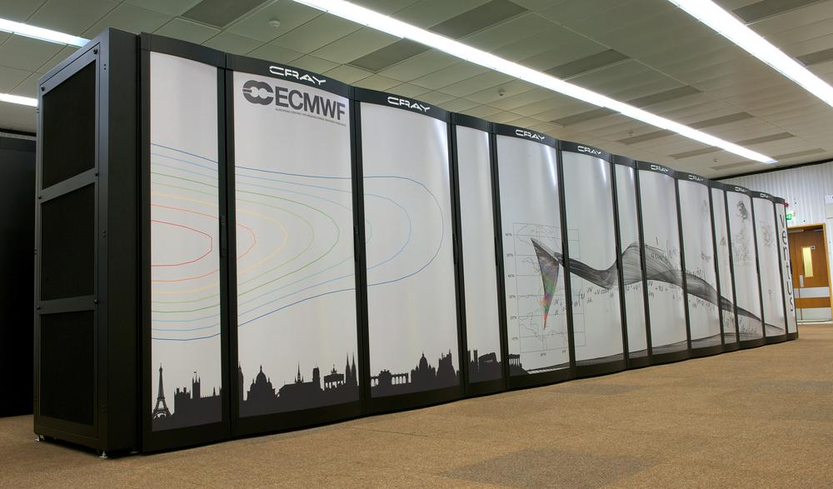
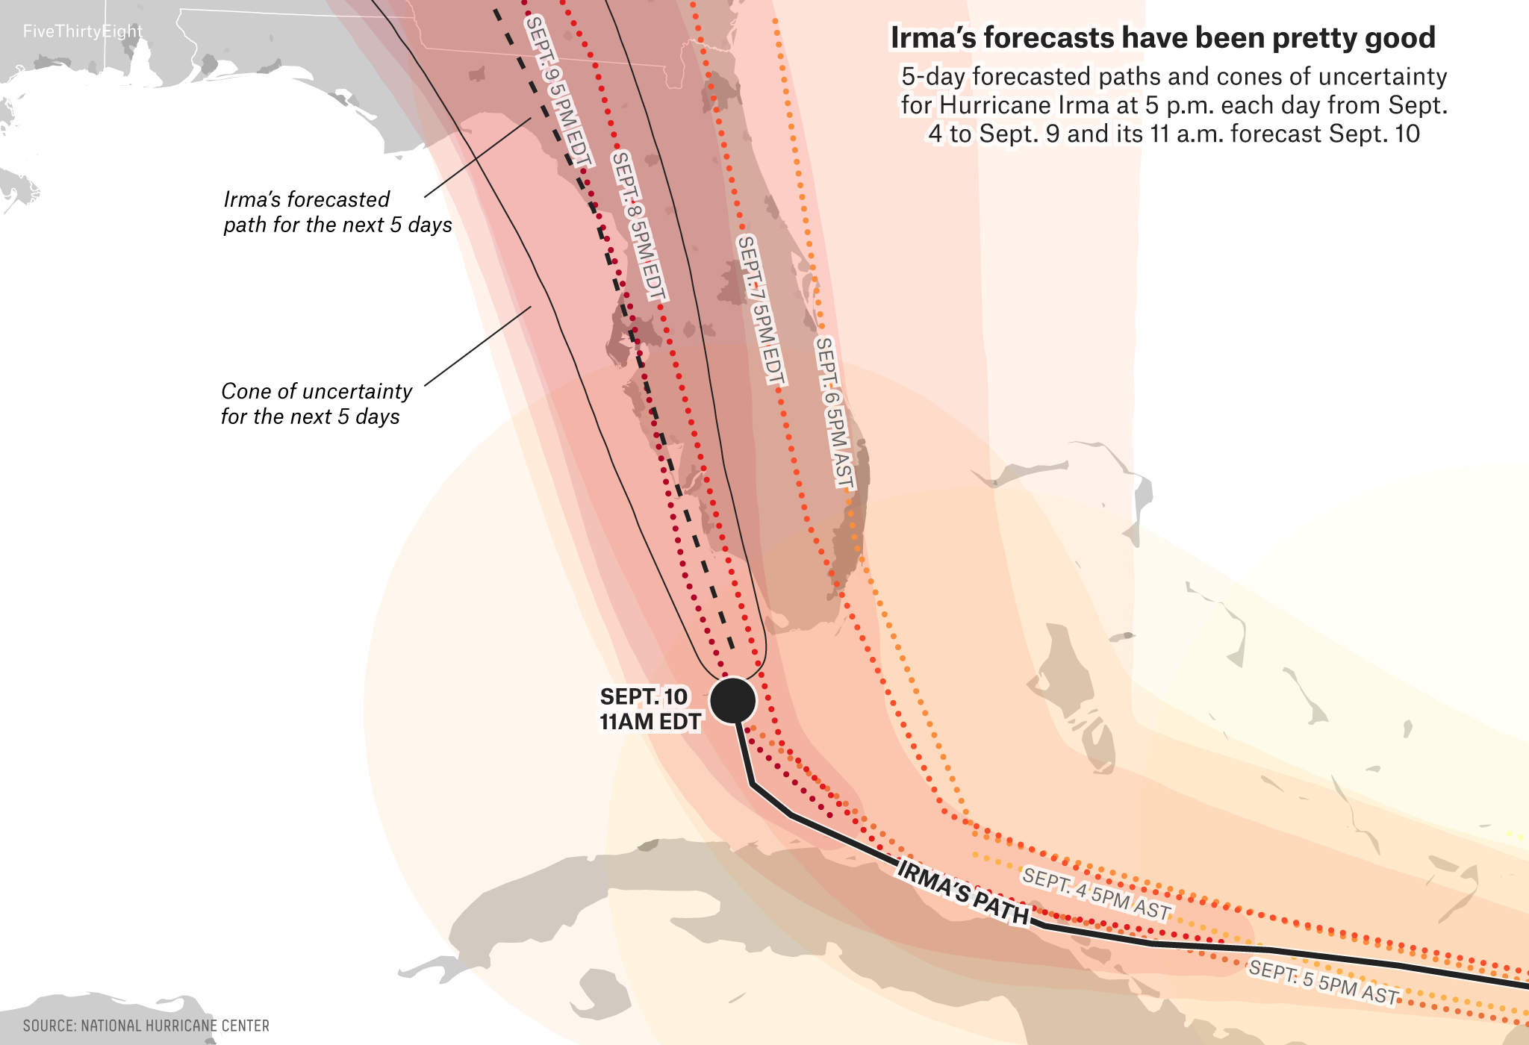
In the News: Why fast computers matter
European Weather supercomputer ECMWF
50 tonnes
~120,000 compute cores (Intel Broadwell)
10 PetaBytes of storage
Runs Linux on each node

Slide 17
Break!
9/14/17

Slide 18
Helpful RISC-V Assembler Features
Symbolic register names
E.g., a0-a7 for argument registers (x10-x17)
E.g., zero for x0
Pseudo-instructions
Shorthand syntax for common assembly idioms
E.g., mv rd, rs = addi rd, rs, 0
E.g.2, li rd, 13 = addi rd, x0, 13

Slide 19
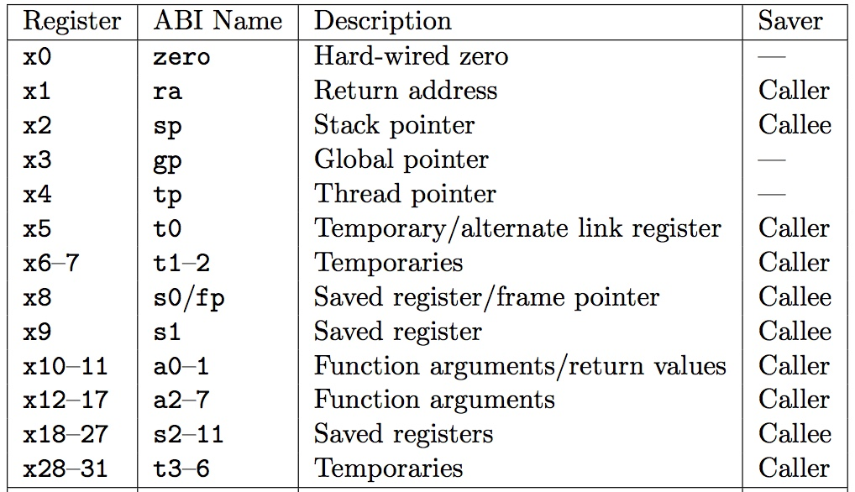
RISC-V Symbolic Register Names
Numbers hardware understands
Human-friendly symbolic names in assembly code

Slide 20
Outline
RISC-V ISA and C-to-RISC-V Review
Program Execution Overview
Function Call
Function Call Example
And in Conclusion …
9/14/17

Slide 21
Six Fundamental Steps in Calling a Function
Put parameters in a place where function can access them
Transfer control to function
Acquire (local) storage resources needed for function
Perform desired task of the function
Put result value in a place where calling code can access it and restore any registers you used
Return control to point of origin, since a function can be called from several points in a program
9/14/17

Slide 22
RISC-V Function Call Conventions
Registers faster than memory, so use them
a0–a7 (x10-x17): eight argument registers to pass parameters and two return values (a0-a1)
ra: one return address register to return to the point of origin (x1)
9/14/17
Notes:
$at – assembler temporary register, used for pseudo instructions

Slide 23
Instruction Support for Functions (1/4)
... sum(a,b);... /* a,b:s0,s1 */ } int sum(int x, int y) { return x+y; }
address (shown in decimal) 1000 1004 1008 1012 1016 … 2000 2004
C
In RISC-V, all instructions are 4 bytes, and stored in memory just like data. So here we show the addresses of where the programs are stored.
RISC-V
9/14/17

Slide 24
Instruction Support for Functions (2/4)
... sum(a,b);... /* a,b:s0,s1 */ } int sum(int x, int y) { return x+y; }
address (shown in decimal) 1000 mv a0,s0 # x = a 1004 mv a1,s1 # y = b 1008 addi ra,zero,1016 #ra=1016 1012 j sum #jump to sum 1016 … # next instruction … 2000 sum: add a0,a0,a1 2004 jr ra # new instr. “jump register”
C
RISC-V
9/14/17

Slide 25
Instruction Support for Functions (3/4)
... sum(a,b);... /* a,b:s0,s1 */ } int sum(int x, int y) { return x+y; }
2000 sum: add a0,a0,a1 2004 jr ra # new instr. “jump register”
C
Question: Why use jr here? Why not use j?
Answer: sum might be called by many places, so we can’t return to a fixed place. The calling proc to sum must be able to say “return here” somehow.
RISC-V
9/14/17

Slide 26
Instruction Support for Functions (4/4)
Single instruction to jump and save return address: jump and link (jal)
Before: 1008 addi ra,zero,1016 #ra=1016 1012 j sum #goto sum
After: 1008 jal sum # ra=1012,goto sum
Why have a jal?
Make the common case fast: function calls very common
Reduce program size
Don’t have to know where code is in memory with jal!
9/14/17

Slide 27
RISC-V Function Call Instructions
Invoke function: jump and link instruction (jal)
(really should be laj “link and jump”)
“link” means form an address or link that points to calling site to allow function to return to proper address
Jumps to address and simultaneously saves the address of the following instruction in register ra
jal FunctionLabel
Return from function: jump register instruction (jr)
Unconditional jump to address specified in register: jr ra
Assembler shorthand: ret = jr ra
9/14/17

Slide 28
Outline
RISC-V ISA and C-to-RISC-V Review
Program Execution Overview
Function Call
Function Call Example
And in Conclusion …
9/14/17

Slide 29
Example
int Leaf (int g, int h, int i, int j)
{
int f;
f = (g + h) – (i + j);
return f;
}
Parameter variables g, h, i, and j in argument registers a0, a1, a2, and a3, and f in s0
Assume need one temporary register s1
9/14/17

Slide 30
Where Are Old Register Values Saved to Restore Them After Function Call?
Need a place to save old values before call function, restore them when return, and delete
Ideal is stack: last-in-first-out queue (e.g., stack of plates)
Push: placing data onto stack
Pop: removing data from stack
Stack in memory, so need register to point to it
sp is the stack pointer in RISC-V (x2)
Convention is grow stack down from high to low addresses
Push decrements sp, Pop increments sp
9/14/17

Slide 31
RISC-V Code for Leaf()
Leaf: addi sp,sp,-8 # adjust stack for 2 items
sw s1, 4(sp) # save s1 for use afterwards
sw s0, 0(sp) # save s0 for use afterwards
add s0,a0,a1 # f = g + h
add s1,a2,a3 # s1 = i + j
sub a0,s0,s1 # return value (g + h) – (i + j)
lw s0, 0(sp) # restore register s0 for caller
lw s1, 4(sp) # restore register s1 for caller
addi sp,sp,8 # adjust stack to delete 2 items
jr ra # jump back to calling routine
9/14/17

Slide 32
Stack Before, During, After Function
Need to save old values of s0 and s1
sp
sp
Saved s1
Saved s1
sp
Saved s0
Saved s0
Before call
During call
After call
9/14/17

Slide 33
Administrivia
HW1 is out! Get started early.
C and Memory Management Guerrilla Session is tonight 7-9pm in 293 Cory
Small group tutoring sessions have launched
9/14/17

Slide 34
New RISC-V book!
“The RISC-V Reader”, David Patterson, Andrew Waterman
Available at
https://www.createspace.com/7439283
Early print edition $9.99
Kindle edition to follow at some point
Recommended, not required

Slide 35
Break!
9/14/17

Slide 36
What If a Function Calls a Function? Recursive Function Calls?
Would clobber values in a0-a7 and ra
What is the solution?
9/14/17
Notes:
Save $ra on the stack

Slide 37
Nested Procedures (1/2)
int sumSquare(int x, int y) { return mult(x,x)+ y; }
Something called sumSquare, now sumSquare is calling mult
So there’s a value in ra that sumSquare wants to jump back to, but this will be overwritten by the call to mult
Need to save sumSquare return address before call to mult
9/14/17

Slide 38
Nested Procedures (2/2)
In general, may need to save some other info in addition to ra.
When a C program is run, there are three important memory areas allocated:
Static: Variables declared once per program, cease to exist only after execution completes - e.g., C globals
Heap: Variables declared dynamically via malloc
Stack: Space to be used by procedure during execution; this is where we can save register values
9/14/17

Slide 39
Optimized Function Convention
To reduce expensive loads and stores from spilling and restoring registers, RISC-V function-calling convention divides registers into two categories:
Preserved across function call
Caller can rely on values being unchanged
sp, gp, tp, “saved registers” s0- s11 (s0 is also fp)
Not preserved across function call
Caller cannot rely on values being unchanged
Argument/return registers a0-a7,ra, “temporary registers” t0-t6
9/14/17

Slide 40
Peer Instruction
Which statement is FALSE?
RED: RISC-V uses jal to invoke a function and jr to return from a function
GREEN: jal saves PC+1 in ra
ORANGE: The callee can use temporary registers (ti) without saving and restoring them
YELLOW: The caller can rely on save registers (si) without fear of callee changing them
9/14/17
Notes:
B: Print It saves PC+4 …because instructions in this system are 4-bytes long and the actual address increments by 4 bytes even though it appears to only increment by one instruction.

Slide 41
Peer Instruction
Which statement is FALSE?
RED: RISC-V uses jal to invoke a function and jr to return from a function
GREEN: jal saves PC+1 in ra
ORANGE: The callee can use temporary registers (ti) without saving and restoring them
YELLOW: The caller can rely on save registers (si) without fear of callee changing them
9/14/17
Notes:
B: Print It saves PC+4 …because instructions in this system are 4-bytes long and the actual address increments by 4 bytes even though it appears to only increment by one instruction.

Slide 42
Allocating Space on Stack
C has two storage classes: automatic and static
Automatic variables are local to function and discarded when function exits
Static variables exist across exits from and entries to procedures
Use stack for automatic (local) variables that don’t fit in registers
Procedure frame or activation record: segment of stack with saved registers and local variables
9/14/17

Slide 43
Stack Before, During, After Function
sp
sp
Saved return address (if needed)
Saved argument registers (if any)
Saved saved registers (if any)
Local variables
(if any)
sp
Before call
During call
After call
9/14/17

Slide 44
Using the Stack (1/2)
So we have a register sp which always points to the last used space in the stack
To use stack, we decrement this pointer by the amount of space we need and then fill it with info
So, how do we compile this?
int sumSquare(int x, int y) { return mult(x,x)+ y; }
9/14/17

Slide 45
Using the Stack (2/2)
sumSquare: addi sp,sp,-8 # space on stack sw ra, 4(sp) # save ret addr sw a1, 0(sp) # save y mv a1,a0 # mult(x,x) jal mult # call mult lw a1, 0(sp) # restore y add a0,a0,a1 # mult()+y lw ra, 4(sp) # get ret addr addi sp,sp,8 # restore stack jr ra mult: ...
int sumSquare(int x, int y) { return mult(x,x)+ y; }
“push”
“pop”
9/14/17

Slide 46
Where is the Stack in Memory?
RV32 convention (RV64 and RV128 have different memory layouts)
Stack starts in high memory and grows down
Hexadecimal (base 16) : bfff_fff0_{hex}
Stack must be aligned on 16-byte boundary (not true in examples above)
RV32 programs (text segment) in low end
0001_0000_{hex}
static data segment (constants and other static variables) above text for static variables
RISC-V convention global pointer (gp) points to static
RV32 gp = 1000_0000_{hex}
Heap above static for data structures that grow and shrink ; grows up to high addresses
9/14/17

Slide 47
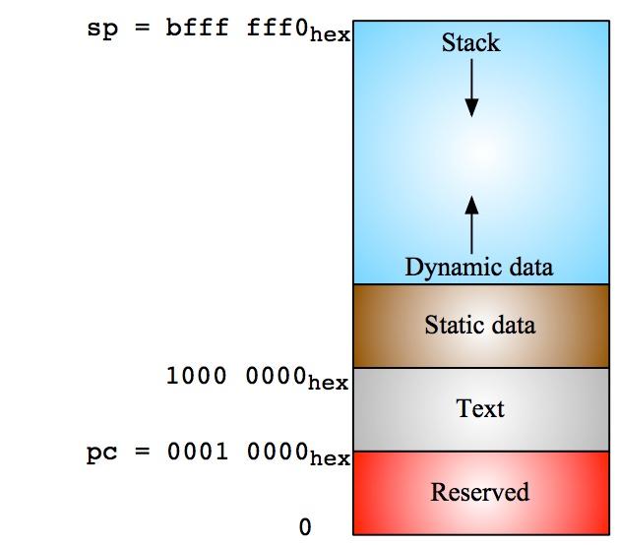
RV32 Memory Allocation
9/14/17

Slide 48
Outline
RISC-V ISA and C-to-RISC-V Review
Program Execution Overview
Function Call
Function Call Example
And in Conclusion …
9/14/17

Slide 49
And in Conclusion …
Functions called with jal, return with jr ra.
The stack is your friend: Use it to save anything you need. Just leave it the way you found it!
Instructions we know so far…
Arithmetic: add, addi, sub
Memory: lw, sw, lb, lbu, sb
Decision: beq, bne, blt, bge
Unconditional Branches (Jumps): j, jal, jr
Registers we know so far
All of them!
a0-a7 for function arguments, a0-a1 for return values
sp, stack pointer, ra return address
s0-s11 saved registers
t0-t6 temporaries
zero
9/14/17

